Slide 1
CODING BLOCKS
An app made to assist the institute in daily management tasks to make learning more fun and efficient.

Slide 2
PROBLEMS PERSISTING
Lack of proper way to keep track of attendance.
Inconvenience of using different portals for each and every task.
Difficulty in keeping track of submissions of students.

Slide 3
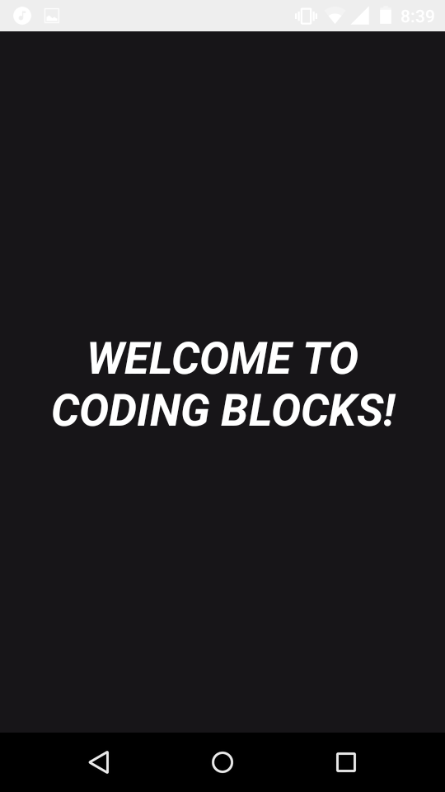
SOLUTION TO ALL SUCH PROBLEMS

Slide 4
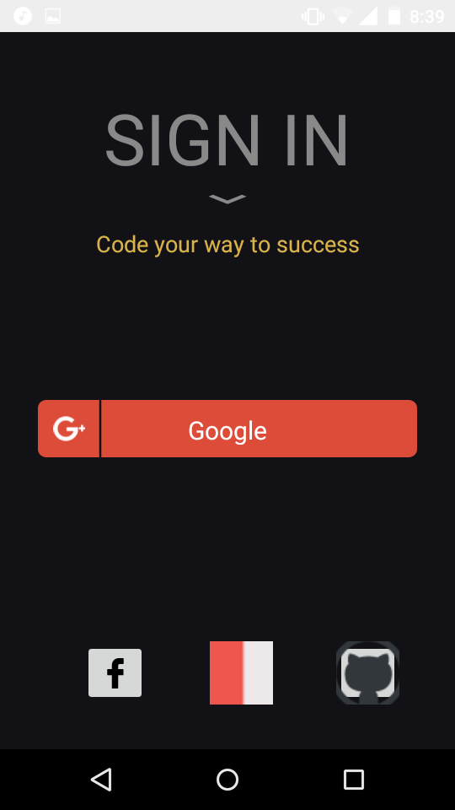
SIGN IN INTO THE APP THROUGH GMAIL ACCOUNT

Slide 5
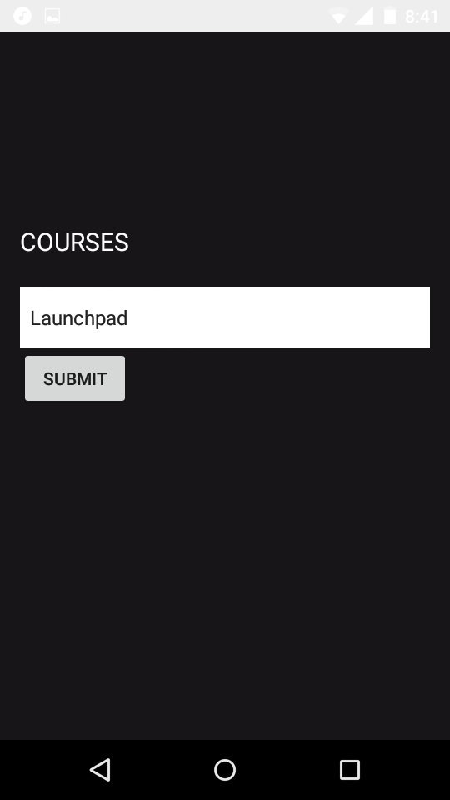
SELECT YOUR COURSE AND CLICK SUBMIT

Slide 6
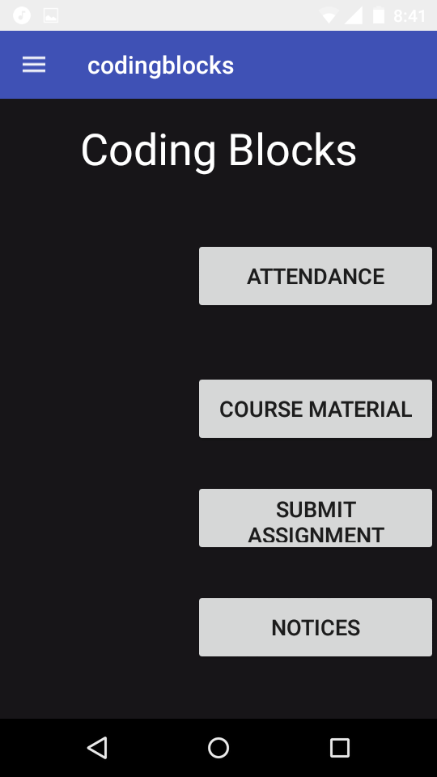
MAIN SCREEN OF THE APP OPENS UP

Slide 7
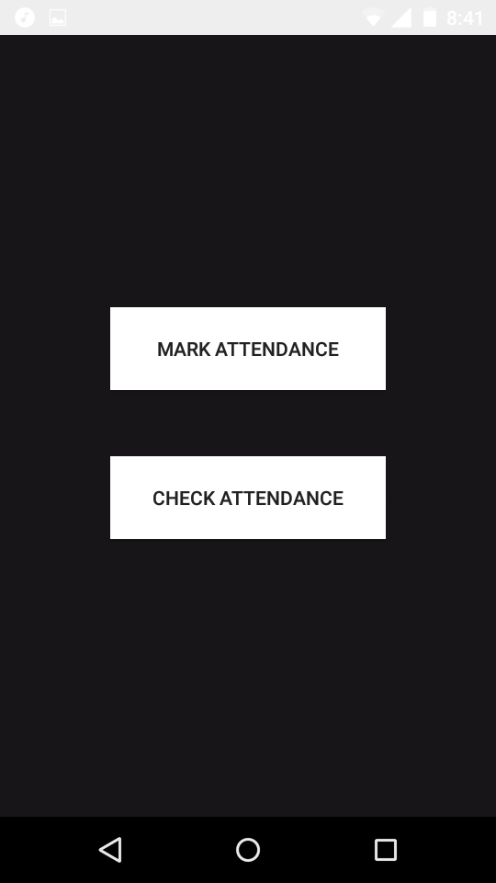
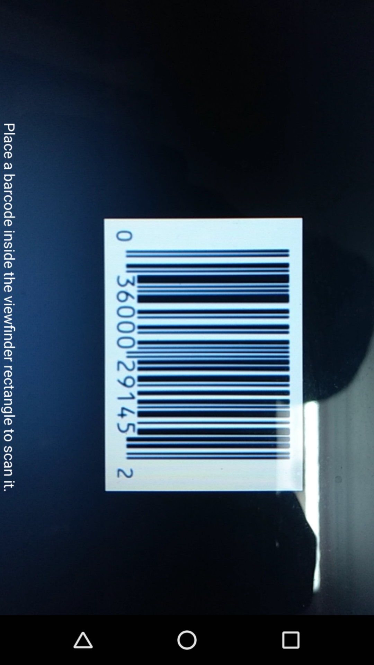
CLICK ON MARK ATTENDANCE
CLICK ON ATTENDANCE

Slide 8
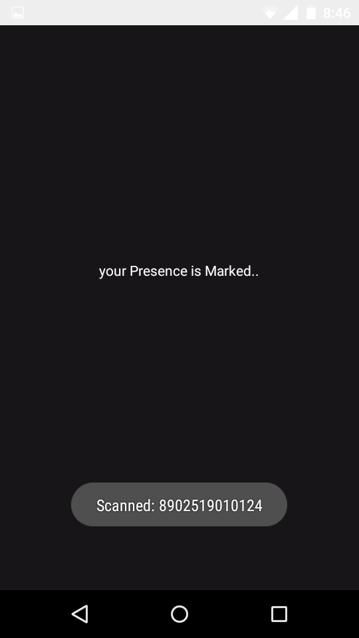
IF U SCAN THE CORRECT BARCODE IN CLASSROOM, UR ATTENDENCE GETS MARKED

Slide 9
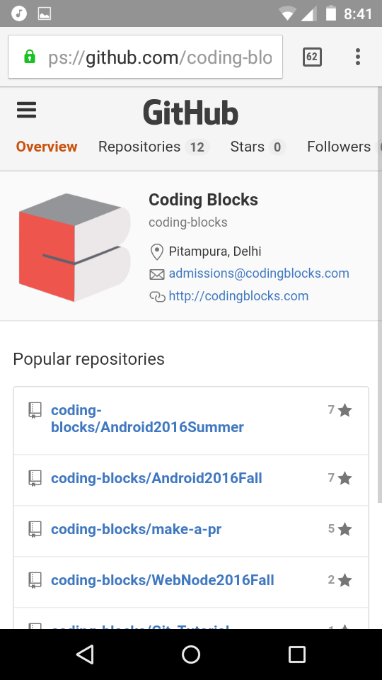
CLICKING ON COURSE MATERIAL OPENS UP GITHUB PAGE OF CODING BLOCKS WHERE RELATED REPOSITORIES CAN BE FOUND

Slide 10
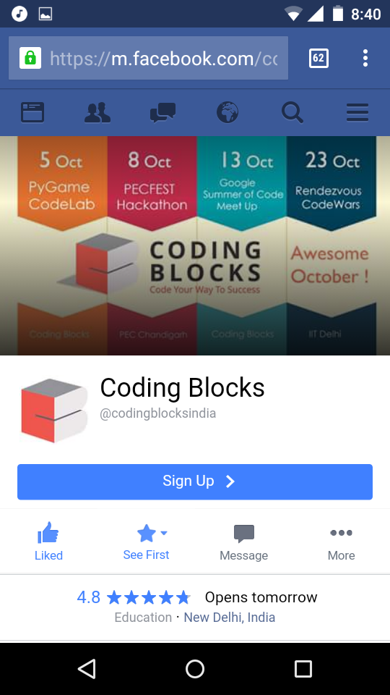
CLICKING ON NOTICES OPENS UP FACEBOOK PAGE OF CODING BLOCKS WHERE RELATED UPDATES CAN BE FOUND

Slide 11
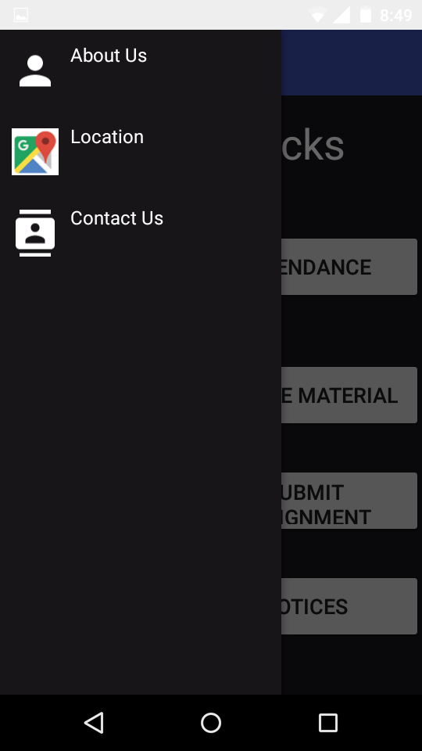
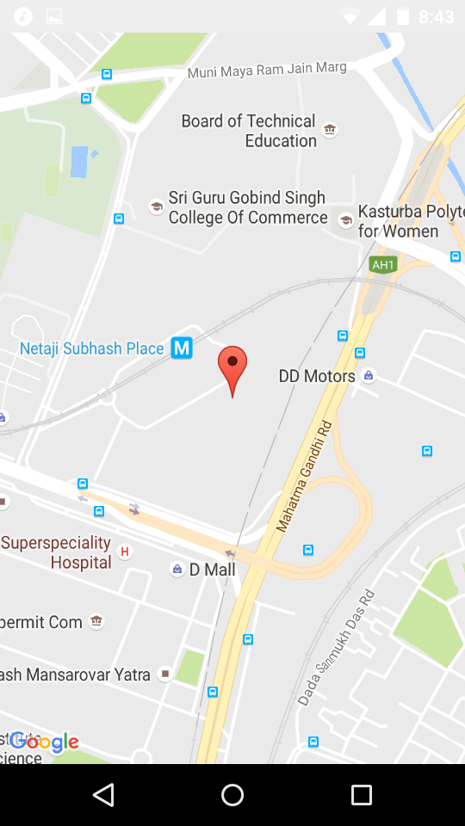
CLICKING ON LOCATION IN NAVIGATION DRAWER OPENS UP LOCATIONOF THE INSTITUTE TO NAVIGATE FOR FRESH BATCH STUDENTS

Slide 12
FUTURE ASPECTS OF THE APP
In future, we are planning to create a backend server for the institute through which we will be able to control real time data in the app such as attendance related data and all and moreover more features will be implemented in the app such as categorising the course material according to different courses by putting up the material on the server category wise and many more..

Slide 13

PRESENTED BY :
TANYA GUPTA
ARCHIT GUPTA

Slide 14


